Slide 1
THE NINA CHATBOT (Your new HOA virtual assistant )
Team #19
RAFAEL PAPA & FRANCIS IFON

Slide 2
VIRTUAL ASSISTANT

Slide 3
What is Virtual Assistant?
A chatbot (or virtual assistant) is a software that can simulate a conversation with a user in natural language through messaging applications.
A chatbot is often described as one of the most advanced and promising expressions of interaction between humans and machines.

Slide 4
THE MAIN GOAL

Slide 5
The Main Goal
To develop a fully functional and user interactive chatbot which can help the HOA (Home Owners Association) to manage daily basis requests (and general information) from users (homeowners)

Slide 6
technologies

Slide 7
Technologies
Application Architecture: JAVA 8 (https://www.oracle.com/technetwork/java/javase/overview/java8-2100321.html)
External API: The IBM Watson (https://www.ibm.com/watson)
Database Application: SQL or CSV file. The Watson
Development Tool: Eclipse Oxygen 1a (https://www.eclipse.org/ )
Designing Tool: PlantUML (Eclipse plugin: http://plantuml.com/eclipse)

Slide 8
Design goals

Slide 9
Design Goals
Authenticate the user in the application .
Connect to the external API (The IBM Watson)
Manage all the messages from the user to the assistant, and vice-versa.
Maintain the connection

Slide 10
FUNCTIONAL SPECIFICATION

Slide 11
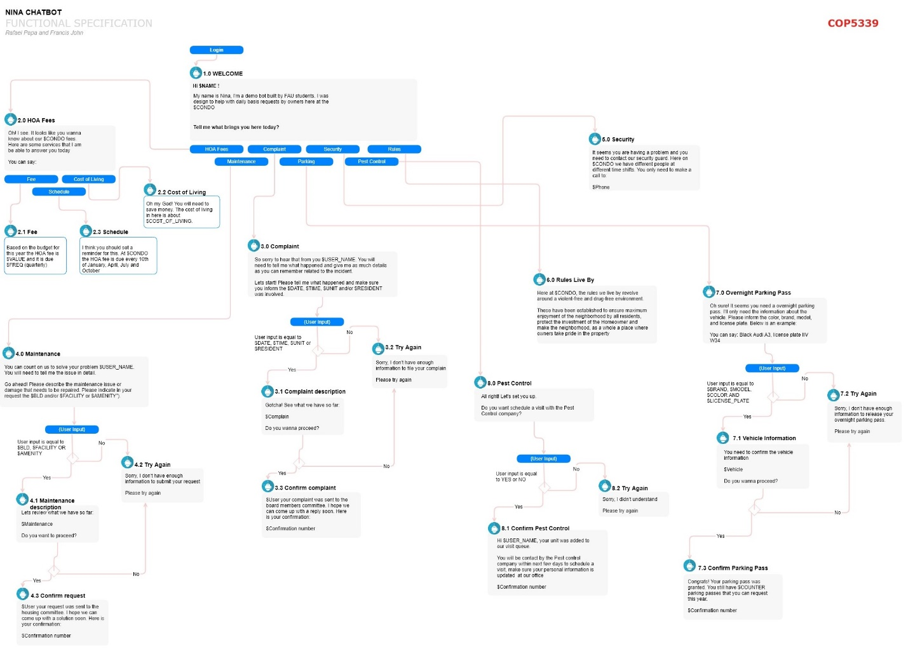
FUNCTIONAL SPECIFICATION

Slide 12
PATTERNS USED

Slide 13
PATTERNS USED
Proxy: To connect to the API (The Watson Assistant)
MVC: To separate the data messages and the control from the view. It is a way to organize the code
Decorator: To add a scroll bar to the main JTextArea (dialogMonitor)
Observer: Notifies Watson when the user finish the request

Slide 14
CLASS DIAGRAM

Slide 15
lessons learned

Slide 16
lessons learned
A 3rd party web service can be a pain in our head, or save our life.
Your code looks much better when programming with design patterns in mind.
Design it first it’s the better strategy.
You will not implement everything you have in your 1st specification. You will have to implement a lot more!

Slide 17
Demo

Slide 18
SEQUENCE DIAGRAMS

Slide 19
SEQUENCE DIAGRAMS

Slide 20
SEQUENCE DIAGRAMS

Slide 21
SEQUENCE DIAGRAMS

Slide 22
SEQUENCE DIAGRAMS

Slide 23
SEQUENCE DIAGRAMS

Slide 24
SEQUENCE DIAGRAMS

Slide 25
SEQUENCE DIAGRAMS

Slide 26
SEQUENCE DIAGRAMS

Slide 27
SEQUENCE DIAGRAMS

Slide 28
SEQUENCE DIAGRAMS

Slide 29
STATE DIAGRAMS

Slide 30
STATE DIAGRAMS

Slide 31
STATE DIAGRAMS

Slide 32
STATE DIAGRAMS

Slide 33
STATE DIAGRAMS

Slide 34
STATE DIAGRAMS

Slide 35
conclusion

Slide 36
conclusion
A chatbot provides quick response when no one is available.
A chatbot can deal with an infinite number of customers at the same time.
Chatbots are the new revolution, especially for customer service, reducing the impact on humans, helping businesses, and saving a significant amount of time as well as money.

